Slide 1

Department of Electronics and Communication Engineering
IV B.Tech II Semester Project Work
Abstract Review Presentation for AY: 2023-24
Batch No:2013
Development of Real Time Bus Tracking and Accident Detection System
Batch Details:
K.Hemalatha
S.Deepthi Reddy
T.Kavya
C.Divija
204G1A0441
214G5A0403
204G1A0454
204G1A0425
Name of the Guide:
Mr.Y.Raja Kullayi Reddy, M.Tech.,Assistant Professor
SRINIVASA RAMANUJAN INSTITUTE OF TECHNOLOGY (Autonomous)
Affiliated to JNTUA| Approved by AICTE| Accredited by NAAC With ‘A’ Grade| Accredited by NBA( EEE , ECE & CSE)
Rotarypuram Village, B K Samudram Mandal, Ananthapuramu - 515701
1

Slide 2

Development of Real Time Bus Tracking and Accident Detection System

Slide 3
OUTLINE OF PRESENTATION:
Justification to the Title
Objective
Introduction
Literature survey
Existing System
Disadvantages
Proposed System
Advantages
Required tools

Slide 4
OBJECTIVE:
The primary objective of the Real-Time Bus Tracking and Accident Detection System is to address the challenges faced by public transportation systems.Firstly, when discussing about transportation, the first thing that comes to mind is waiting for public transportation. Tracking public transportation buses is a cost-effective solution to this issue that provides some real time data continuously and accurate data.
This project achieves below key points:
Continuously tracking the bus.
Getting updated data continuouly.
Enhanced Safety
Improved reactive accident response.
Enhanced Passenger Experience

Slide 5
JUSTIFICATION TO THE TITLE:
Bus Tracking System is about knowing the location of the Bus through GPS .
The vehicle tracking system uses the GPS module to get geographic coordinates at regular time intervals to user mobile .
In case of fire incidents and accidents then immediately notification reach to management they will take action .
It enables the students to find out the exact location of the buses so that they will not get late or will not arrive at the bus stop too early.
Real Time Bus Tracking and Accident Detection System

Slide 6
INTRODUCTION:
Nowadays, buses are used rapidly as a transportation system in the different organization, e.g., school, college, university, business firm, banks, etc. But, with the increase of population, vehicles are increasing day by day which is further leading to heavy traffic.
In this introduction, we delve into the core components and objectives of the proposed system. Firstly, we explore the necessity for real-time bus tracking in enhancing passenger experience and operational efficiency. Secondly, we discuss the imperative for an accident detection system to swiftly respond to emergencies and ensure passenger safety.

Slide 7
LITERATURE SURVEY 1:
Title:A Real-Time GPRS Vehicle Tracking System Displayed on a Google-Map-Based Website(2011).
Author:Prawat Chaiprapa, Supaporn Kiattisin and Adisorn Leelasantitham.
This paper uses GPRS Module for tracking the vehicle and sending the data to Website.
This paper proposes a real-time vehicle tracking system using a global positioning system (GPS) technology module to receive the location of the vehicle.
PHP and AJAX language will be developed for the Google Map .
Drawbacks:
The small error for tracking vehicles is at approximately 5 meters in the wrong location due to the limitation of hardware.
Here PHP & AJAX are both old technologies.So present online compilers are not supporting to these technologies.

Slide 8
LITERATURE SURVEY 2:
Title:How Long to Wait?: Predicting Bus Arrival Time with Mobile Phone based Participatory Sensing(June 2014).
Author: P. Zhou, Y. Zheng, and M. Li.
In this paper,the bus arrival time prediction system based on Crowd participatory sensing.
Crowd participatory sensing refers to when a large group of people actively contribute data or information to a sensing system.
It's like a collective effort to gather and share data for various purposes.
Drawback:
Sometimes there is no reliability of the collected data.
Sometimes, people may lose interest to actively contribute data over time.

Slide 9
LITERATURE SURVEY 3:
Title:Low-Cost Campus Bus Tracker using WiFi Access Points.
Author:KuanYew Tan, and KokSheik Wong( May 2016).
WiFi internet access point can be found almost everywhere nowadays. While location data from GPS enables successful fleet management, the WLAN infrastructure has been also deployed to track objects.
Proximity which estimates the location of an object when it is approaching a known location
Scene analysis which is an image processing based method to compare the current scene to the collected information in an existing database of scene images tagged with location information.
Drawback:There is no GPS & GSM modules for tracking location of bus and sharing the longitudes & latitutes to users mobile.
It is difficult to establish WIFI points.

Slide 10
LITERATURE SURVEY 4:
Title:Real-Time Tracking Management System Using GPS and Google Earth.
Author:N. Chadil, A. Russameesawang, and P. Keeratiwintakor.
Our real-time tracking management system is an open system that uses a free and open source software and is composed of commodity hardware that is easy-to-find.
The GPS tracking device is an embedded system that transmits location information to the server through GPRS network
The server is a personal computer that receives the information and put it in the database. The database formats the information in a special form that can search and display using Google Earth software or Google Map.
Drawback:
After tracking the vehicle location the message should send to users/owner cell phone.But here there is no GSM module to send the message.

Slide 11
Existing System:
1.The Existing System is live location sharing through Whatsapp.
2.Enable location permissions for WhatsApp in your phone's Settings > Tap Apps.
3.WhatsApp > Permissions > Location > turn on WhatsApp....
4.Open an individual or group chat.
5.Tap > Location > Share live location>Enter.

Slide 12
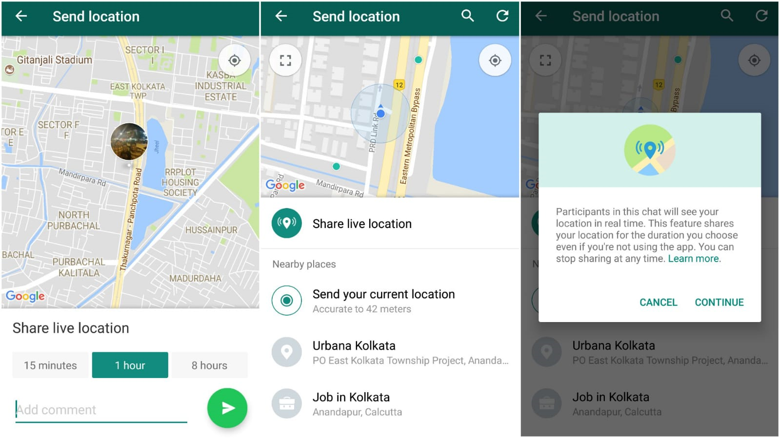

Slide 13
DISADVANTAGES:
1.Location is needed to be shared manually.
2.Someone are required to inform manually inorder to get the rescue teams when an accident occurs.
3.The live location cannot be shared to bulk strength.
4.The WhatsApp Live Location sharing feature is not permanent and you will have the option to share your real-time location.
5.We can share location for every 15 minutes, 1 hour or 8 hours with someone or a group.
6.No real time data updates.
7.No advanced route optimizations.
8.No Reactive Accident Response

Slide 14
PROPOSED SYSTEM:
The Real-Time Bus Tracking and Accident Detection System consists of two main components: the Real-Time Bus Tracking system and the Accident Detection system.
Real-Time Bus Tracking System:
Utilizes GPS and IoT technologies to monitor the location and movement of buses in real-time.
Allows passengers to access bus location information through a mobile application or web interface.
Enables passengers to plan their journeys more effectively and reduce waiting times at bus stops.

Slide 15
Accident Detection System:
Integrated into buses, utilizing sensors such as Vibration Sensor and Fire Sensor.
Monitors the vehicle's behavior and surroundings continuously.
Detects irregularities or collisions that may indicate an accident.
Automatically sends alerts to emergency services and relevant authorities in the event of an accident, facilitating swift response and potentially saving lives
Overall, the proposed system offers a comprehensive solution to enhance the management and safety aspects of public bus transportation, leveraging advanced technologies to create a more efficient, reliable, and secure public transportation experience for all stakeholders.

Slide 16
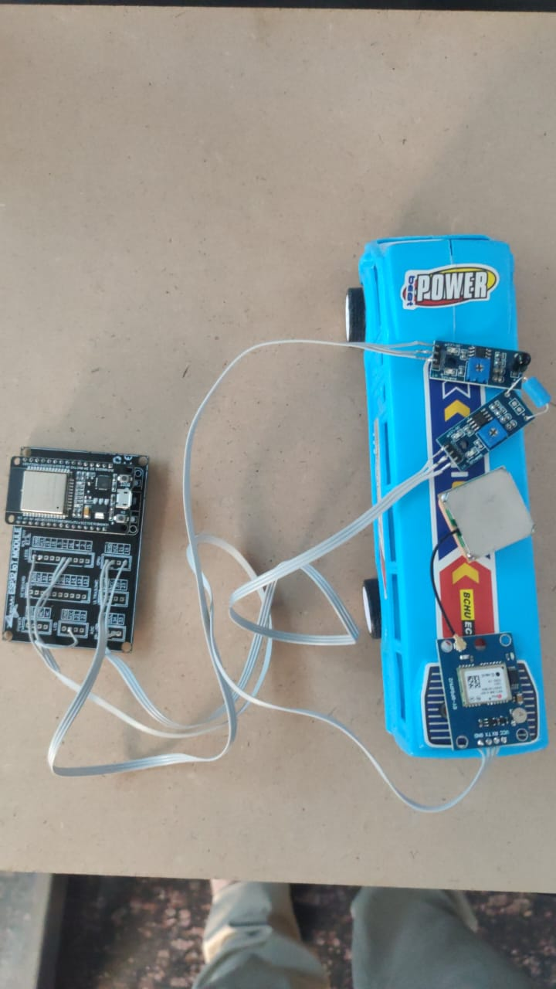

Slide 17
BLOCK DIAGRAM:
Cloud
MQTT
ESP32 Microcontroller
Vibration Sensor
Pushbullet
App
Fire Sensor
Folium Map

Slide 18
Detailed Explanation of Each Block:
Vibration Sensor:
A vibration sensor, also known as a vibration detector or accelerometer, is a device designed to detect and measure vibrations or oscillations in an object or system.
These sensors can detect various types of vibrations, including mechanical vibrations caused by machinery or vehicles, seismic vibrations caused by earthquakes, and even human-induced vibrations.
Vibration sensors typically consist of a sensing element, such as a piezoelectric crystal .
Fire Sensor:
A fire sensor is a device designed to detect the presence of fire or smoke.
These sensors are crucial components of fire alarm systems, as they can quickly detect the early signs of a fire.

Slide 19
GPS(Global positioning system):
The main aim is to find out the location of the bus.
The vehicle tracking system uses the GPS module to get geographic coordinates at regular time intervals.
ESPB2 MCU:
The ESP32 MCU (Microcontroller Unit) is a powerful and versatile microcontroller developed by Espressif Systems. It is part of the ESP32 series of chips, which integrate Wi-Fi and Bluetooth connectivity along with a dual-core processor,
The ESP32 MCU offers a rich set of features, including GPIO (General Purpose Input/Output) pins, ADC (Analog-to-Digital Converter), DAC (Digital-to-Analog Converter), SPI (Serial Peripheral Interface), I2C (Inter-Integrated Circuit), UART (Universal Asynchronous Receiver-Transmitter), and PWM (Pulse Width Modulation) capabilities.

Slide 20
Pushbullet Application:
Integrating Pushbullet with an ESP32 microcontroller to send notifications in the event of fire incidents and accidents is a practical application, especially in settings like college campuses where safety is a priority.
Visual Studio Code:
We use Visual Studio Code to keep the Folium map updated continuously. It helps us write and edit the code that powers the map, ensuring that the bus locations are always accurate and up-to-date.
Folium Map:
We use Folium maps for tracking buses continuously. These maps are easy to use and anyone can track the bus locations on them. It's like using a regular map on your phone, but specifically designed for tracking buses.

Slide 21
REQUIRED TOOLS
Hardware Requirements:
Vibration Sensor
Fire Sensor
GPS
ESP32MCU
Software Requirements:
Arduino IDE
Pushbullet App
Visual Studio Code
Folium Map

Slide 22
ADVANTAGES:
Updated location can reach the users for every interval of time.
Enhanced Safety: The integration of an accident detection system significantly improves passenger safety by enabling swift response to accidents or emergencies, potentially saving lives.
Real-Time Tracking: Passengers can track the location and movement of buses in real-time, allowing for better trip planning and reduced waiting times at bus stops, thus enhancing overall convenience.
Data Analysis for Improvement: The collection and analysis of data generated by the system can provide valuable insights for ongoing improvements and innovation in public transportation infrastructure, leading to continuous enhancement of service quality

Slide 23
APPLICATIONS:
Educational Institutions can use this system for tracking school buses.
Employee Transportation in Corporation can use bus tracking to manage employee transportation, ensuring timely arrivals for employees and reducing transportation-related stress.
Traffic Management: Assist traffic management authorities in monitoring and managing bus routes.
In rural areas for public transportaion buses.
In urban areas for public transportaion buses.
By tracking the buses,government authorities can provide services to different routes based on the analysis .

Slide 24
RESULTS:
The Real-Time Bus Tracking and Accident Detection System has shown promising results. Here are some of the key outcomes observed:
Improved Passenger Experience.
Increased Safety.
Effective Emergency Response.
Alerts and Notifications.
Real time data will be there.
Advanced route optimizations.
No manual sharing need.
Getting updated data continuouly.
Continuous Tracking wil be there.

Slide 25
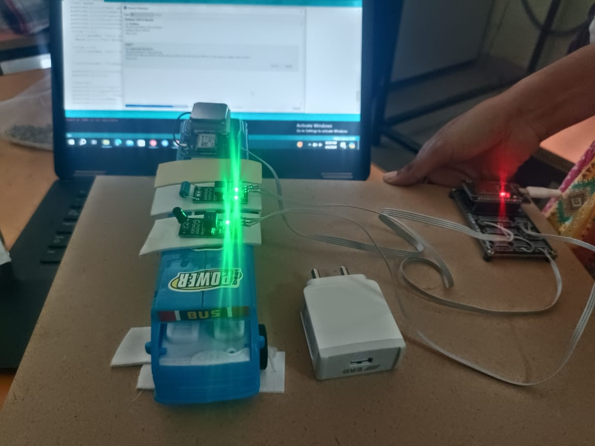
Fig 1:Uploading Code to ESP32

Slide 26
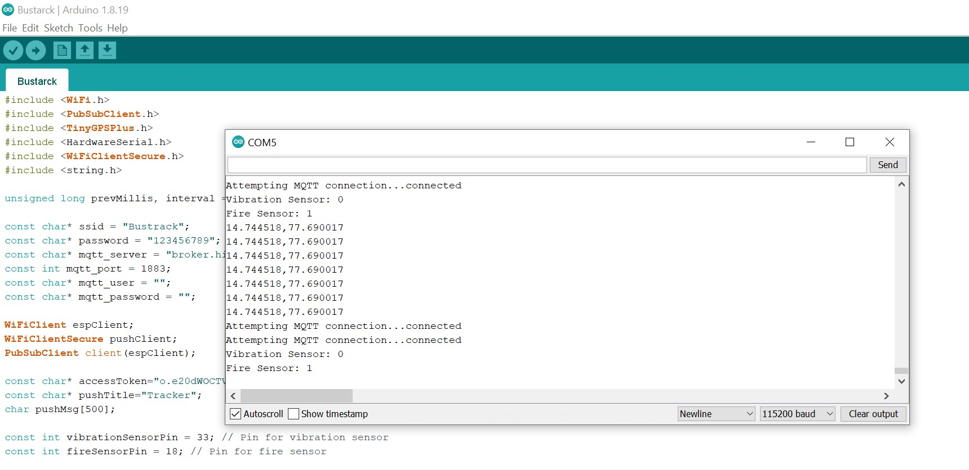
Fig 2:Getting longitudes and latitudes in Serial Monitor
Fig 1. & Fig 2 illustrates the process of writing code in the Arduino IDE, followed by compiling the code and uploading it to the ESP32 microcontroller. Once the compilation and uploading processes are successfully completed, the longitude and latitude coordinates of the bus are displayed in the Serial Monitor.

Slide 27
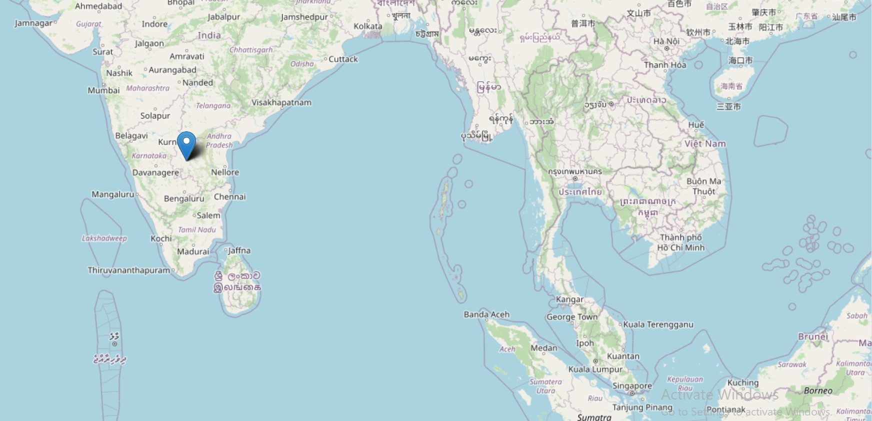
Fig 3 :Tracking in Folium Map
Figure 3 illustrates the continuous tracking of the bus on a Folium map. By clicking on the address pointer displayed on the map, users can view the corresponding longitude and latitude coordinates. Notably, the longitude and latitude coordinates displayed on the Folium map and the Serial Monitor are identical.

Slide 28
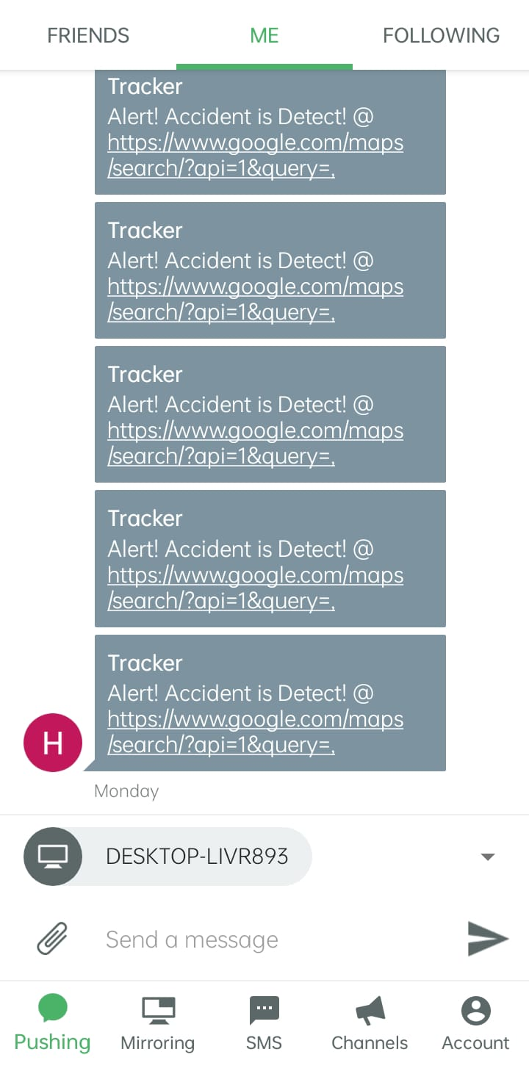
Fig 4 : Notifications of Accidents in Pushbullet App
Figure 4 illustrates the notification process in the event of fire incidents or accidents. Notifications are sent immediately to the management team to ensure prompt response and action.

Slide 29
CONCLUSION:
In conclusion, the Real-Time Bus Tracking and Accident Detection System serve as a foundation for ongoing innovation in public transportation management and safety. Continued research and development in this field promise to further enhance the efficiency, reliability, and sustainability of urban transportation systems, ultimately benefiting society as a whole.
The integration of an Accident Detection System further enhances safety by promptly identifying and reporting accidents to emergency services and relevant authorities.

Slide 30
Thank You

